Slide 1
Sleeping Barber Problem
Muhammad Amin

Slide 2
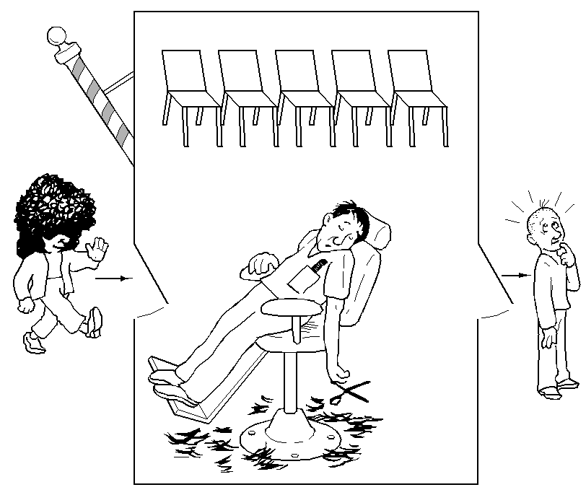
Sleeping Barber Problem
There is one barber, and n chairs for waiting customers
If there are no customers, then the barber sits in his chair and sleeps (as illustrated in the picture)
When a new customer arrives and the barber is sleeping, then he will wakeup the barber
When a new customer arrives, and the barber is busy, then he will sit on the chairs if there is any available, otherwise (when all the chairs are full) he will leave.
April, 2025
Operating Systems - Muhammad Amin

Slide 3
Barber Shop Hints
Consider the following:
Customer threads should invoke a function named getHairCut.
If a customer thread arrives when the shop is full, it can invoke balk, which exits.
Barber threads should invoke cutHair.
When the barber invokes cutHair there should be exactly one thread invoking getHairCut concurrently.
April, 2025
Operating Systems - Muhammad Amin

